Slide 1


Slide 2
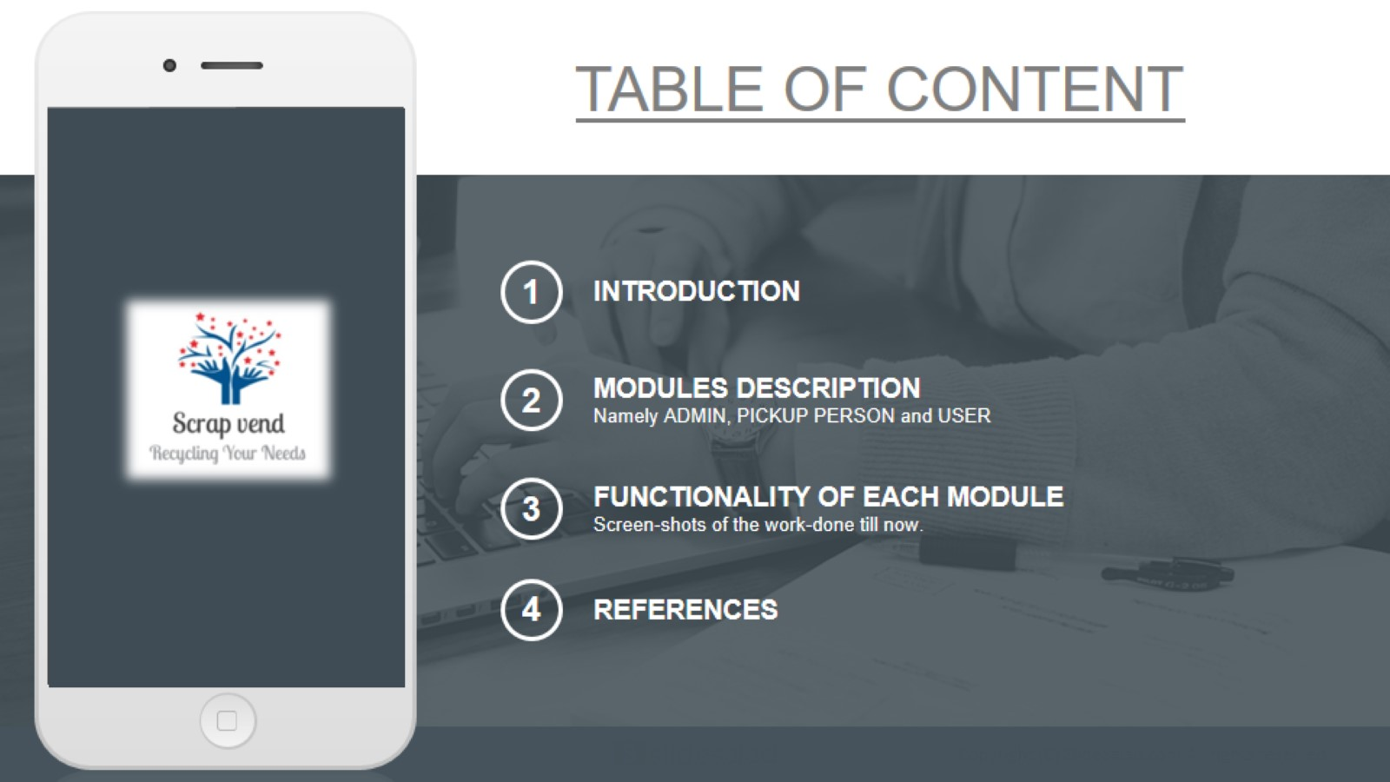
TABLE OF CONTENT

Slide 3


Slide 4
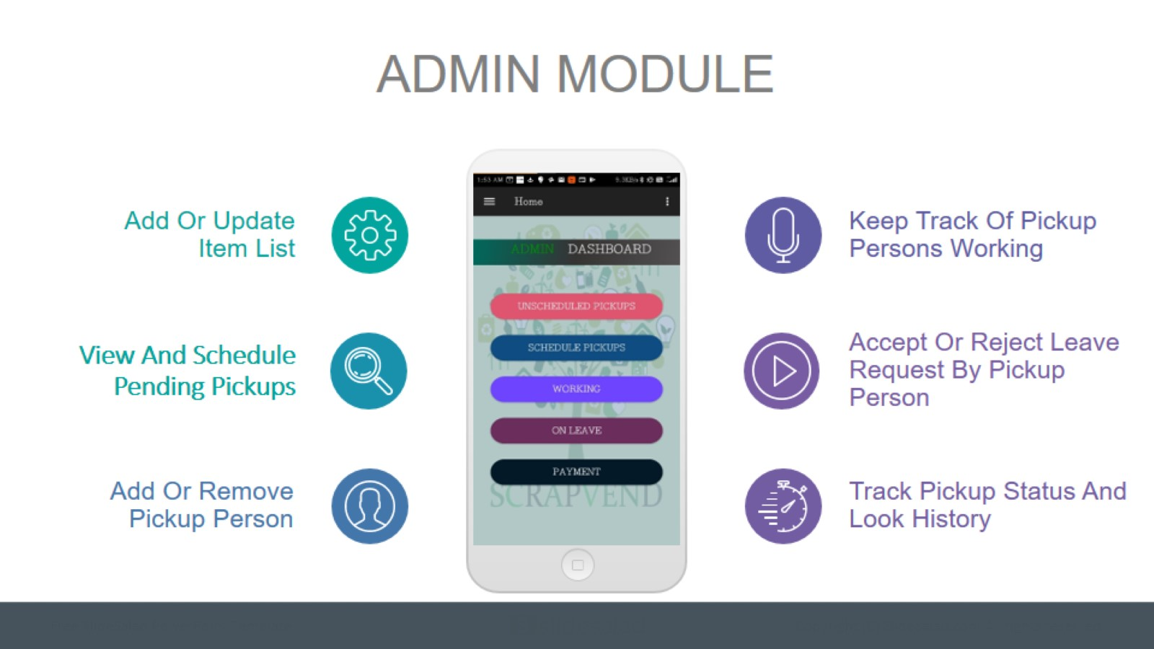
ADMIN MODULE

Slide 5
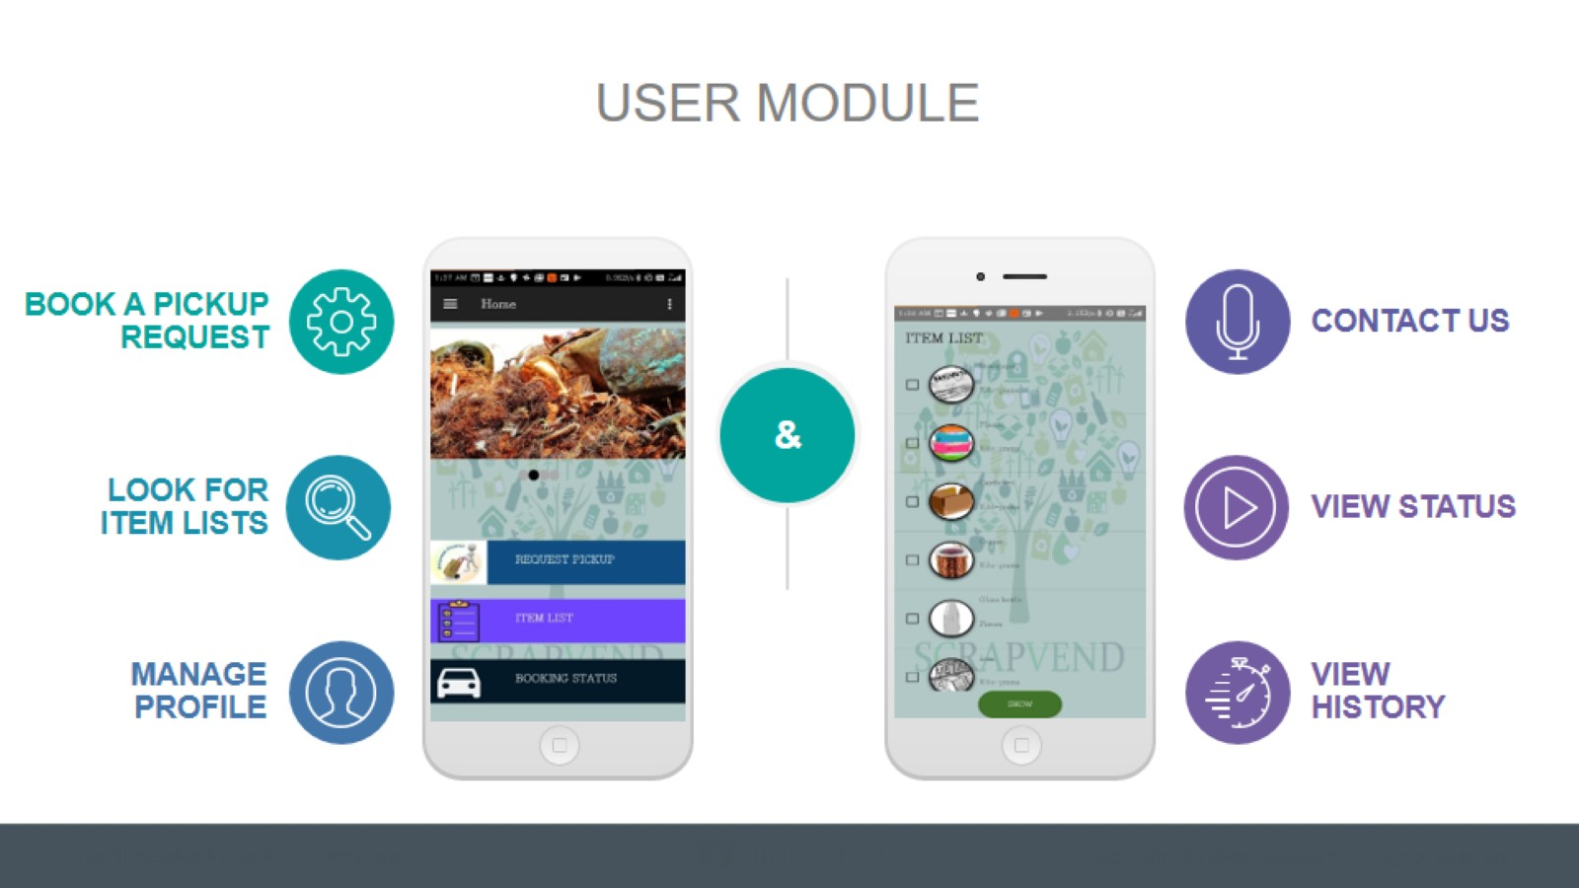
USER MODULE

Slide 6
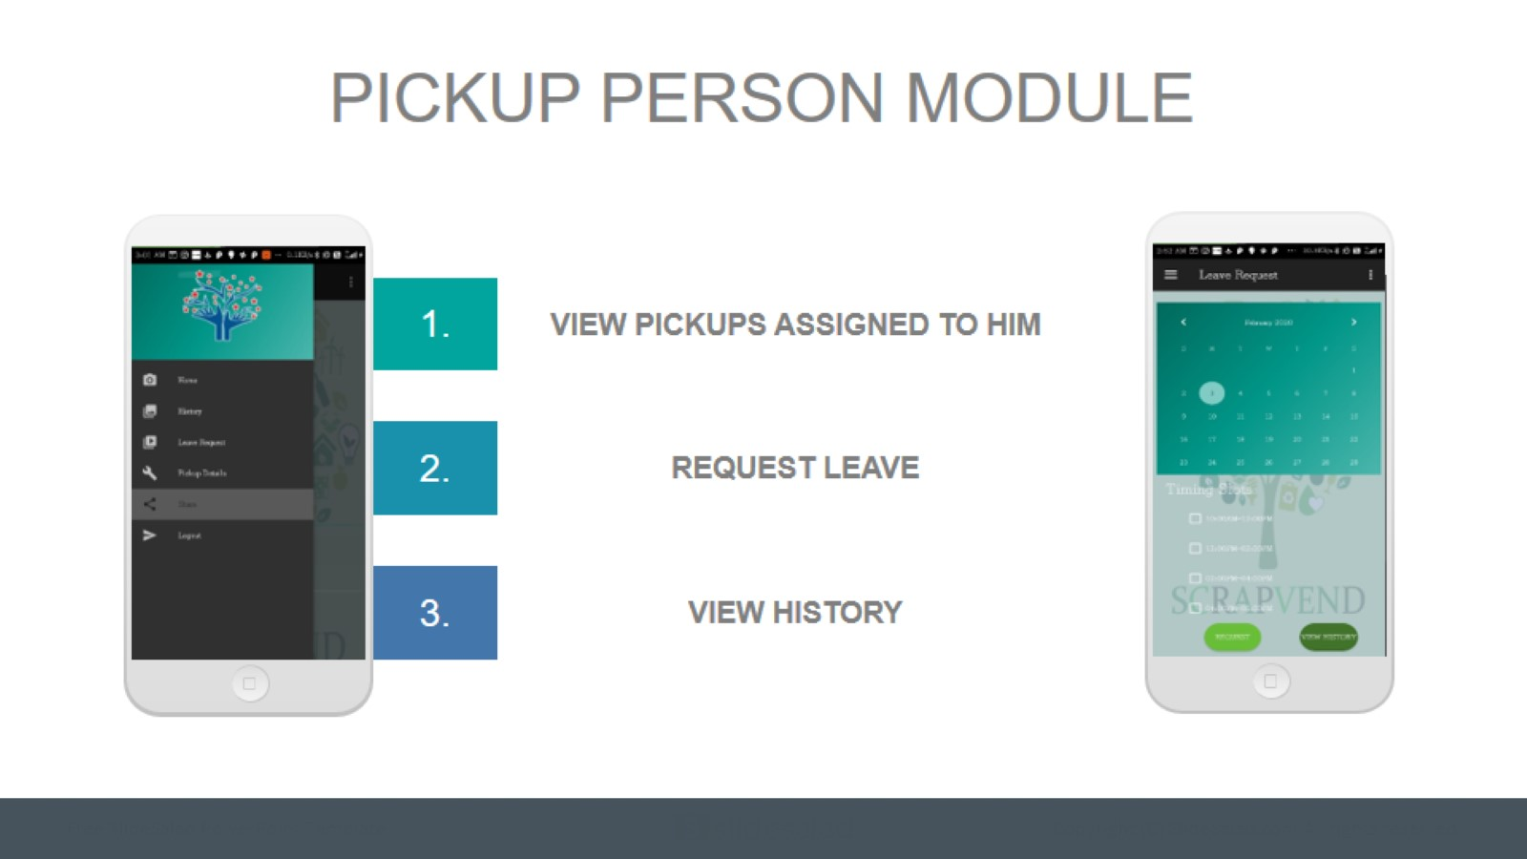
PICKUP PERSON MODULE

Slide 7
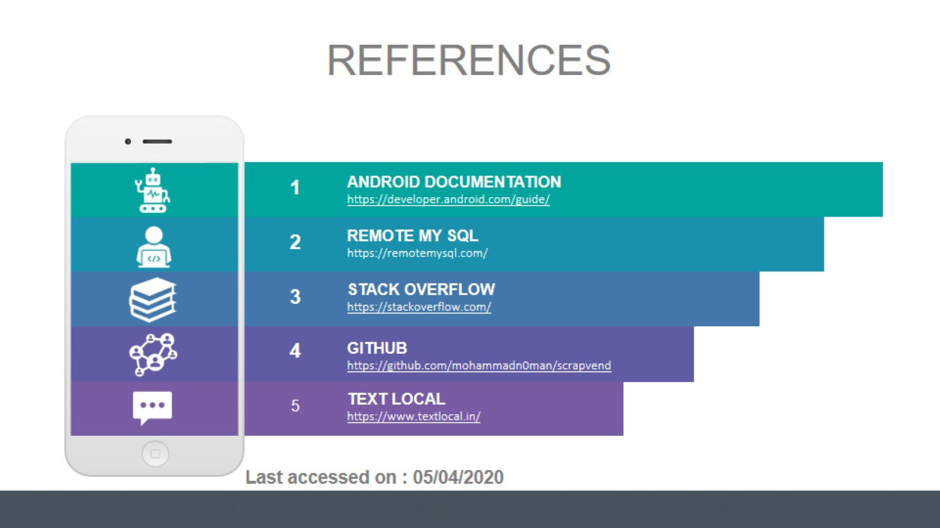
REFERENCES

Slide 8


